Slide 1
Total Quality Management
Copyright © 2016, 2013, 2010 Pearson Education, Inc. All Rights Reserved.
Notes:
If this PowerPoint presentation contains mathematical equations, you may need to check that your computer has the following installed:
1) MathType Plugin
2) Math Player (free versions available)
3) NVDA Reader (free versions available)

Slide 2
Quality
Quality
Quality is the ability of a product or service to consistently meet or exceed customer expectations.
(What customers wants that is the quality)
Defect
Any instance when a process fails to satisfy its customer

Slide 3
Dimensions of Quality
Manufactured Product
Performance
Features
Reliability
Conformance
Durability
Serviceability
Aesthetics
Safety
Service Product
Timeliness
Completeness
Courtesy
Consistency
Accessibility and Convenience
Accuracy
Responsiveness

Slide 4
Quality parameters
1. Performance: primary operating characteristics of the product; they are usually measurable, e.g. fuel consumption of an automobile, seating space, hard disk capacity of a computer, writing capacity of pen or pencil, etc.
2. Features: additional characteristics that enhance the product/services appeal to the user, e.g. digital speedometer or cassette recorder in an automobile, rubber attached to a pencil, internet services on a mobile phone, etc.
3. Reliability: likelihood that a product will not fail within a specific time period, e.g. number of defects occurring in a car or any machine in one year’s use, or failure rate of mobile set per annum, etc.
4. Conformance: precision with which the product meets the specified standards (Acceptable Quality Level), e.g. compliance to specification of a product when manufactured, e.g. Vendors’ Acceptable Quality Level, etc.

Slide 5
Quality parameters
5. Durability: measures the length of a product’s life, e.g. 15 years or 20 years of useful life of a car, 1-2 years of an ordinary ink pen, etc.
6. Serviceability: speed with which the product can be put into service when it breaks down, e.g. time to carry out the service of a car, software fixing time when it fails (or crashes), etc.
7. Aesthetics: subjective dimension indicating the kind of response a user has to a product. It represents the individual’s personal preference-the way an individual responds to the look, feel, sound, taste and smell, e.g. color and décor of a car
8. Perceived Quality: a subjective dimension; it is the quality attributed to a good or service based on indirect measures, e.g. brand popularity

Slide 6
Costs of Quality Category
Costs of Quality
Costs of conformance
Costs of non-conformance
Prevention costs
Appraisal costs
Internal failure
costs
External failure
costs
Prevention Costs
quality planning
new product review
supplier quality
evaluation
training
product design
processing
Information
Appraisal Costs
incoming inspection
in-process inspection
final inspection and
testing
product quality audits,
maintaining accuracy
of testing equipment
Internal Failure Costs
scrap
rework
failure analysis
repeated service
repeated production
re-investigation
refuse
External Failure Costs
servicing
guarantees and
returning
product canceling
costs
warranty charges
complaint adjustment
returned material
allowances

Slide 7
Costs of Quality
Prevention costs
Costs associated with preventing defects before they happen [All TQ training, TQ planning, customer assessment, process control, and quality improvement costs to prevent defects from occurring]
Appraisal costs
Costs incurred when the firm assesses the performance level of its processes [raw material check, quality audit, supplier rating, checking final product]
Internal Failure costs
Costs resulting from defects that are discovered during the production of a service or product [defect products and associated raw material cost, overhead, labor cost]
External Failure costs
Costs that arise when a defect is discovered after the customer receives the service or product [refurbishing, retaking item, logistics]

Slide 8
Common Myth
High quality, High cost (Not true)
High Quality
Low Quality
Preventive Cost
Internal failure cost
External failure cost

Slide 9
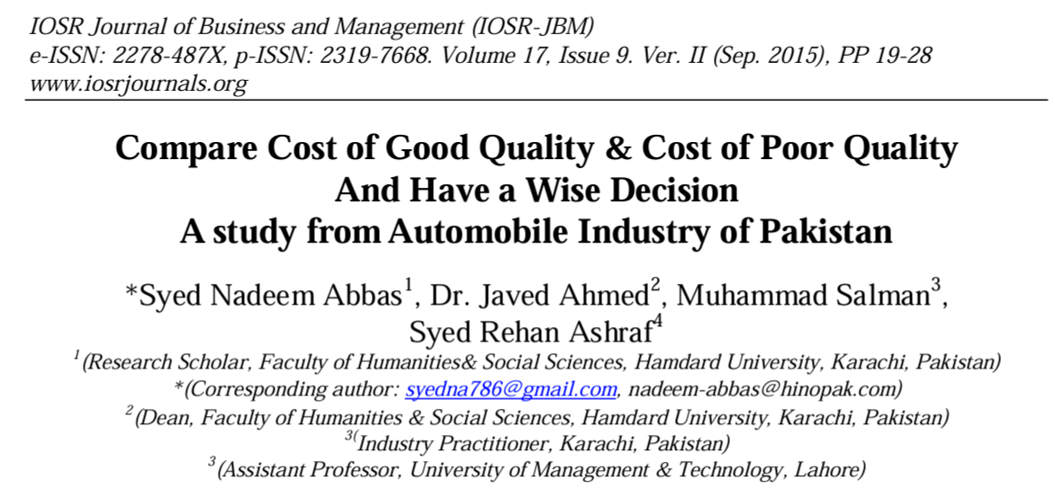
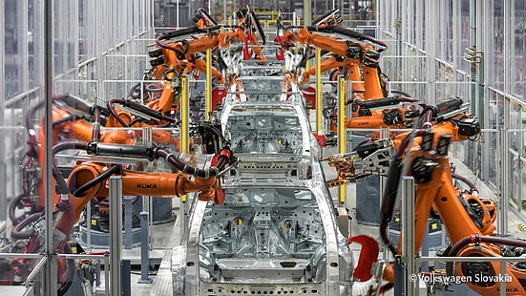
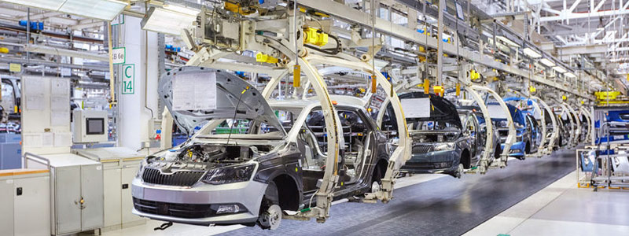
An example

Slide 10
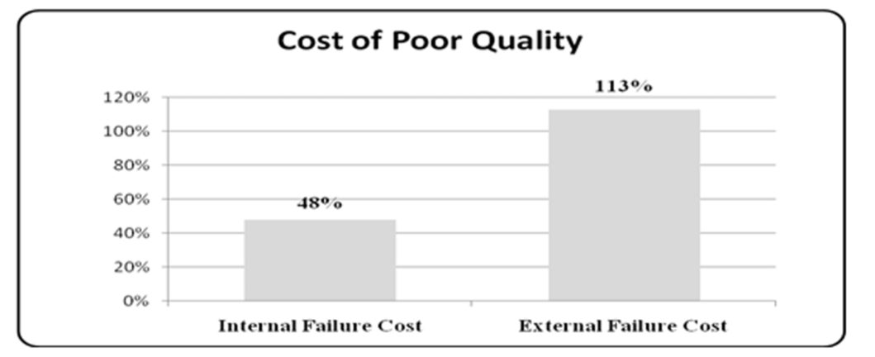
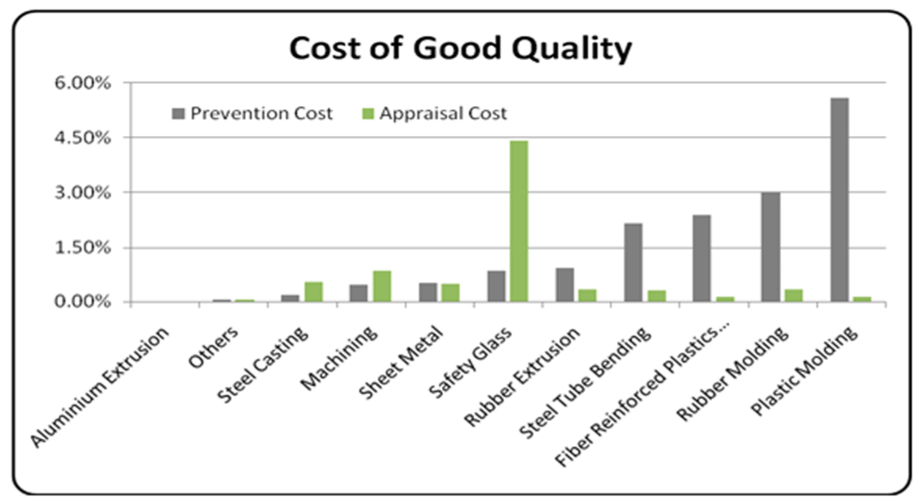
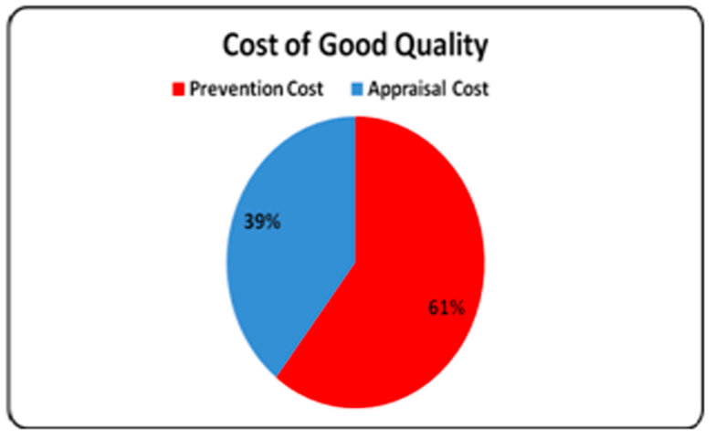
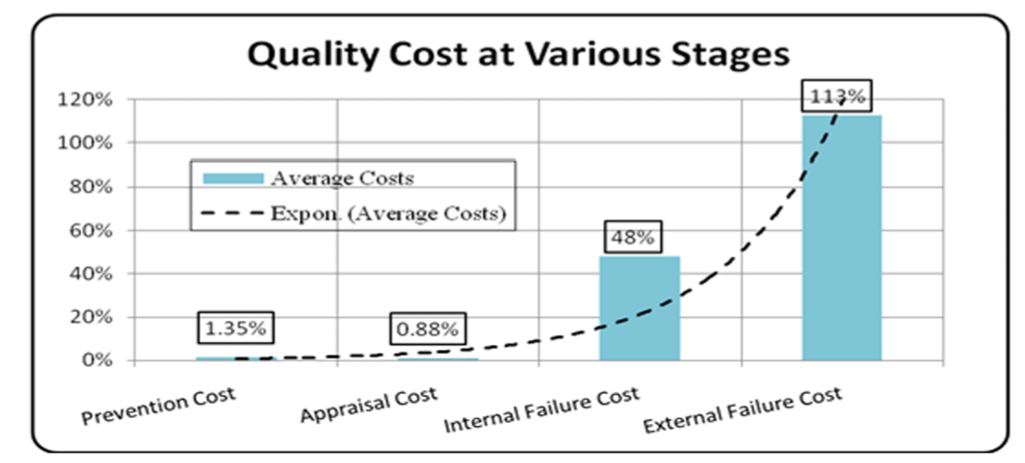
Study showed that the cost of good quality is 22 ~ 50 times lower than cost of poor quality and this comparative ratio is derived and may be used as rule of thumb.

Slide 11
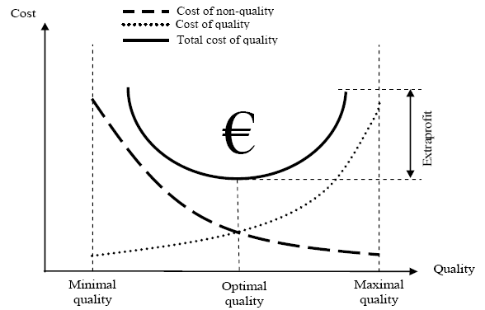
Key Aspects of Quality Costs
Cost of quality model

Slide 12
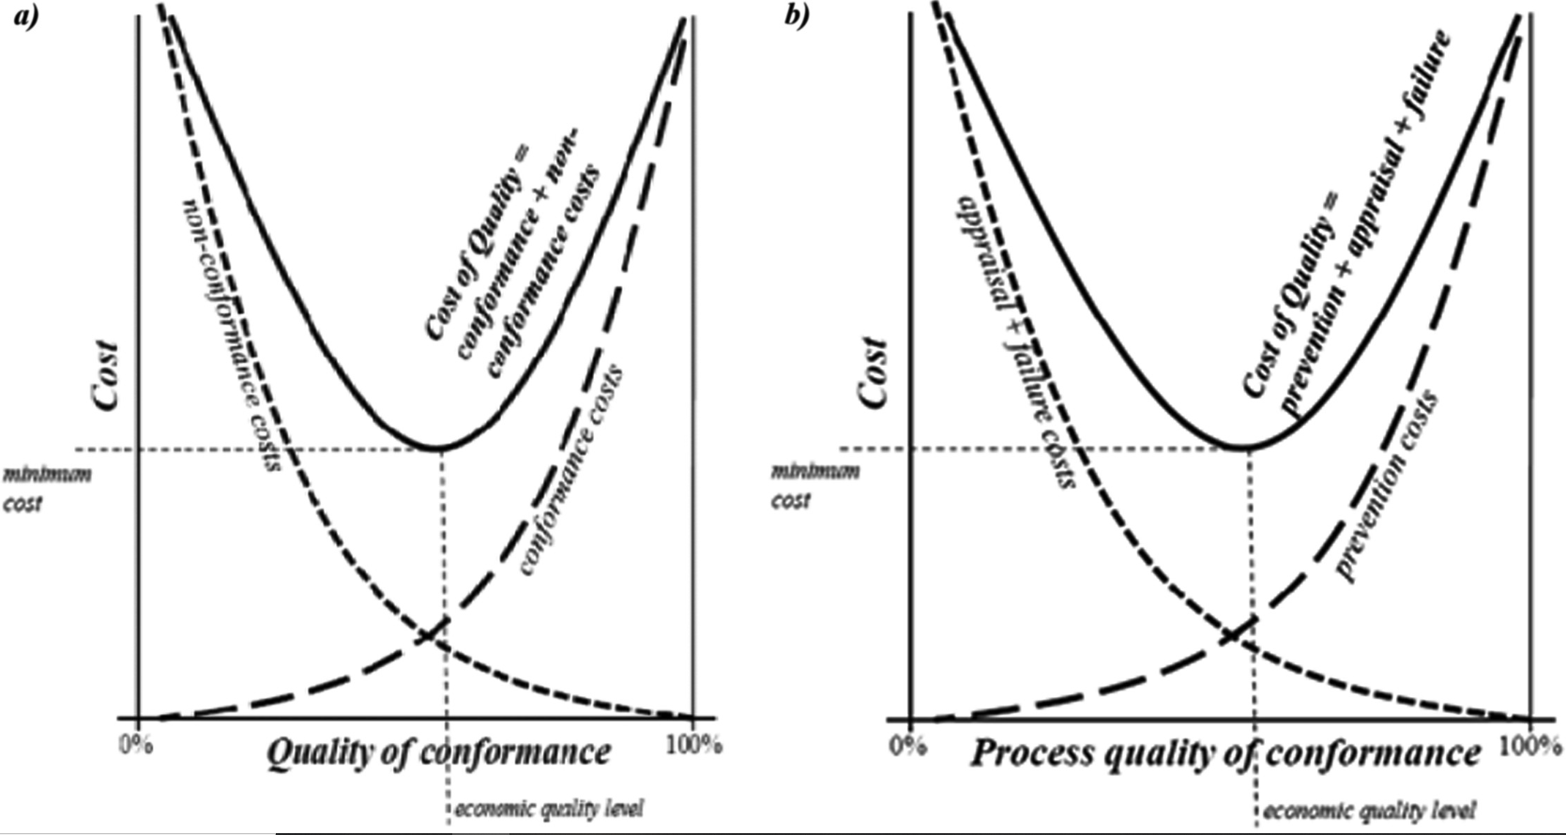
Lundvall-juran curve

Slide 13
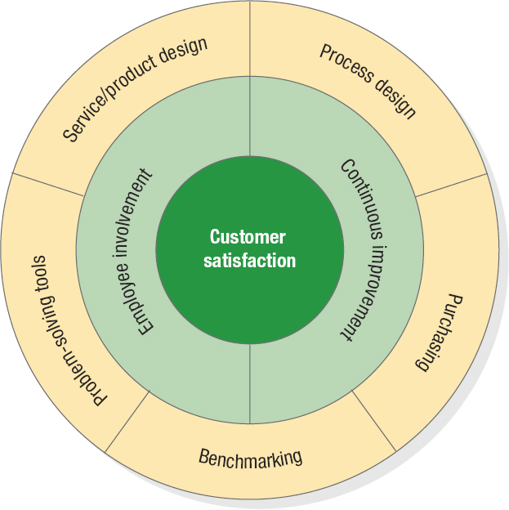
Total Quality Management
Total Quality Management
A philosophy that stresses three principles (customer satisfaction, employee involvement and continuous improvement) for achieving high level of process performance and quality
Figure TQM Wheel

Slide 14
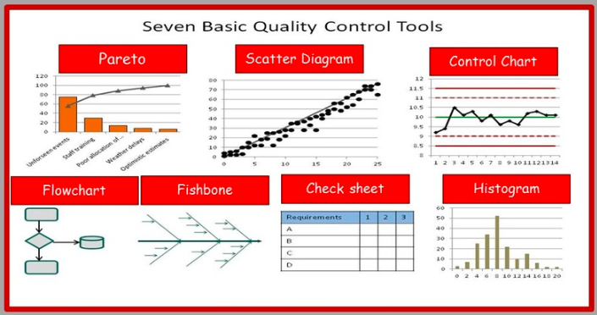
7 Basic QC tools

Slide 15
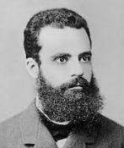
Pareto analysis
Vital few-Trivial many
ABC analysis
80-20 rule
Vilfredo Pareto, (born July 15, 1848, Paris, France—died August 19, 1923, Geneva, Switzerland), Italian economist and sociologist
80% wealth belong to less than 20% people

Slide 16
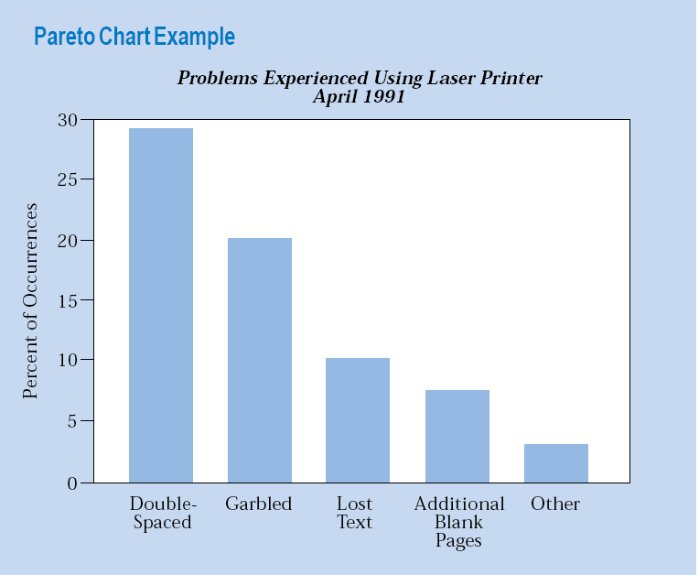
Pareto Chart Example

Slide 17
Example 1
Construct a Pareto diagram from the data given in the table below.
Category | Frequency
Wrong medicine | 15
Medicine dc'd | 4
Wrong dose | 100
Wrong patient | 8
Wrong time | 70
Missed dose | 3
Grand Total | 200

Slide 18
Category | Frequency | Percent of total | Cumulative %
Wrong dose | 100 | 50 | 50
Wrong time | 70 | 35 | 85
Wrong medicine | 15 | 7.5 | 92.5
Wrong patient | 8 | 4 | 96.5
Medicine dc'd | 4 | 2 | 98.5
Missed dose | 3 | 1.5 | 100
Grand Total | 200 | 100% | 100%

Slide 19
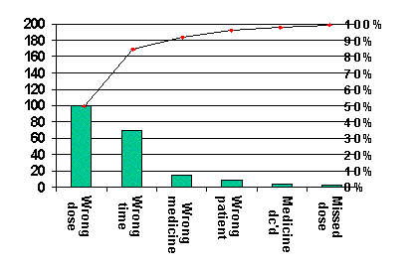

Slide 20
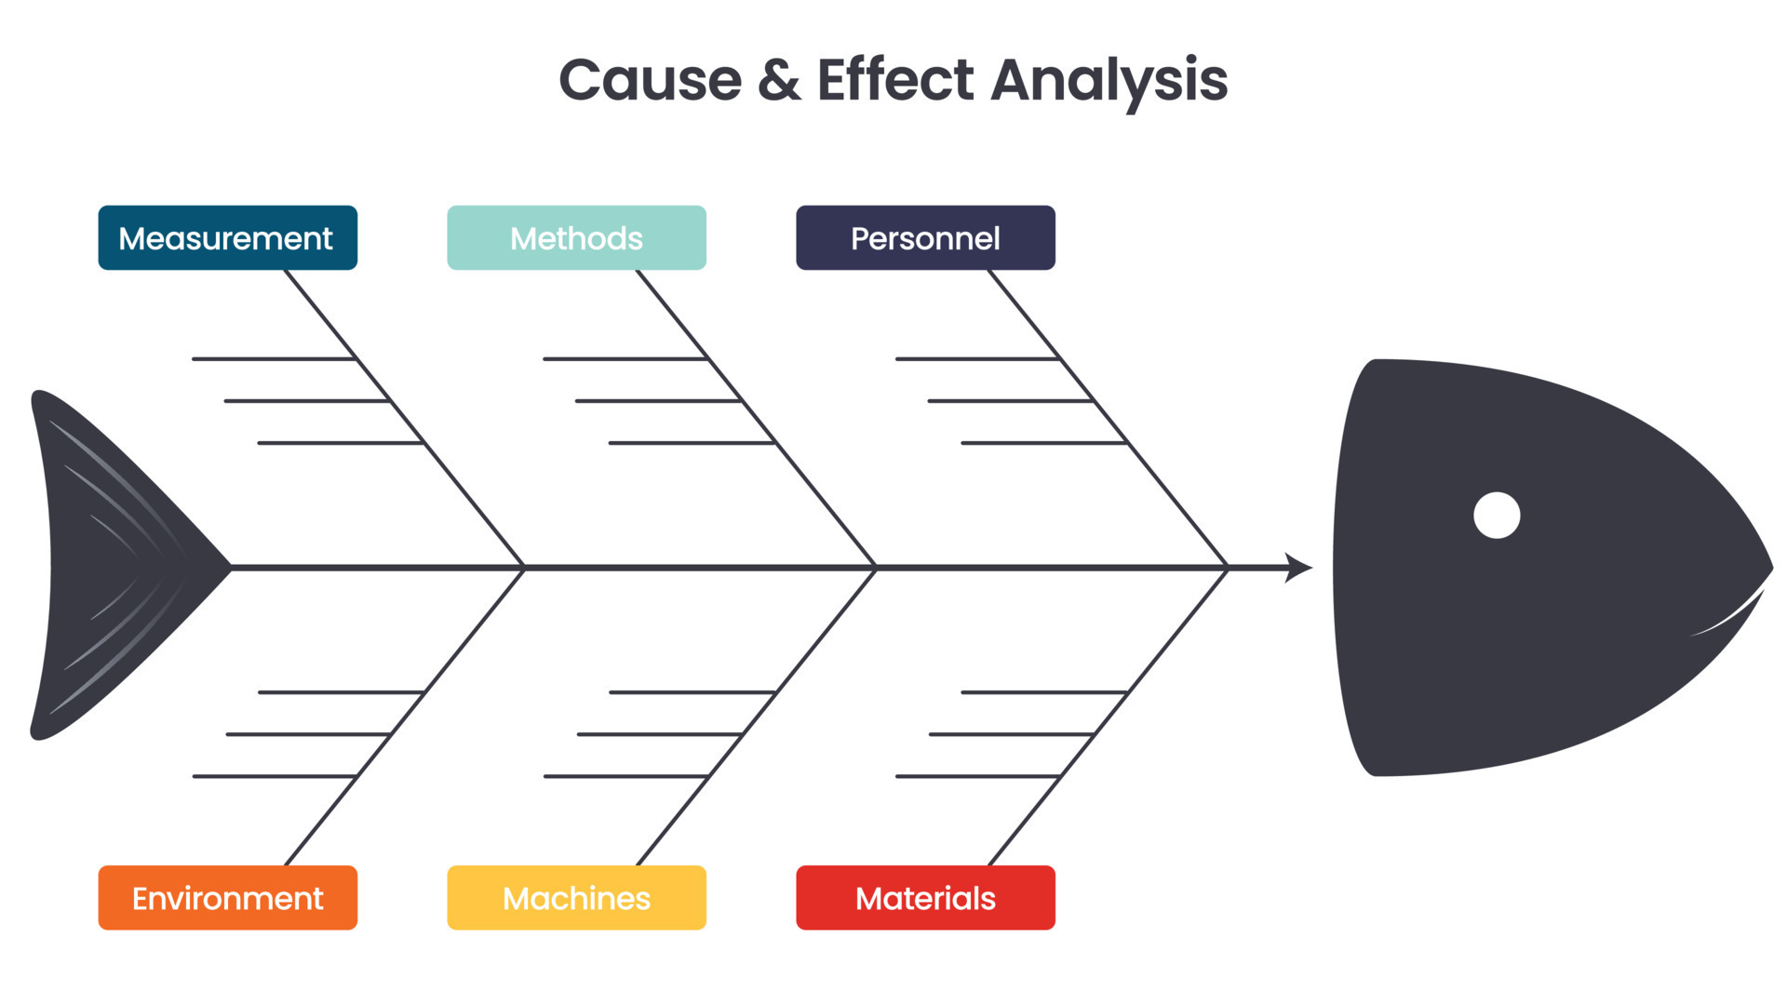
Cause effect diagram (Ishikawa diagram/ Fish-bone diagram)

Slide 21
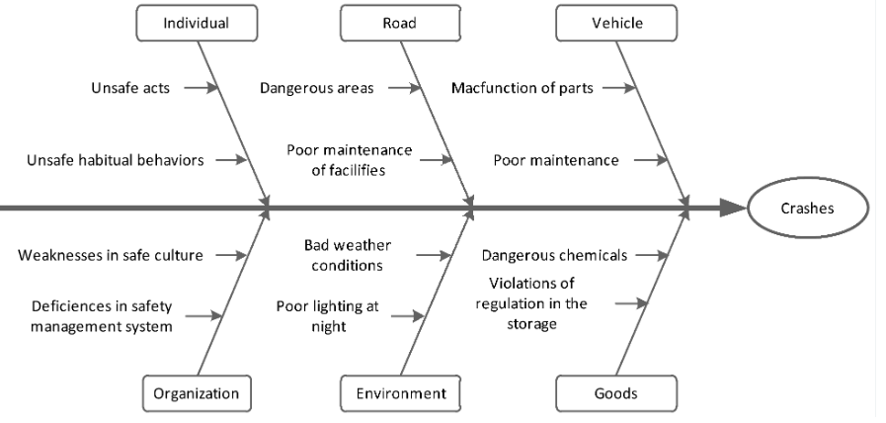
Example of fishbone diagram for road crash

Slide 22
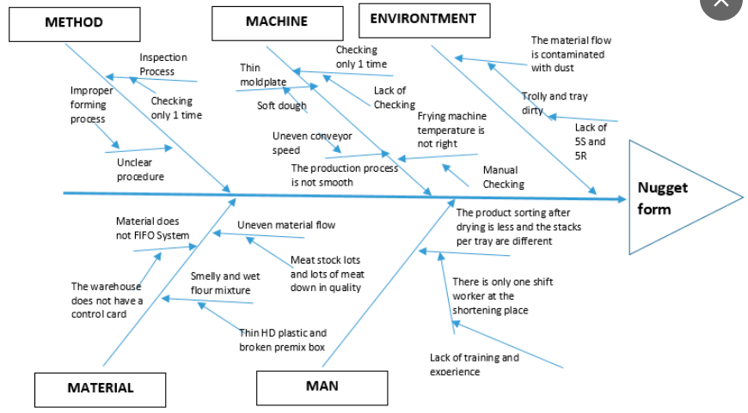
Example of fishbone diagram for a particular defect (Nugget form) in a product

Slide 23
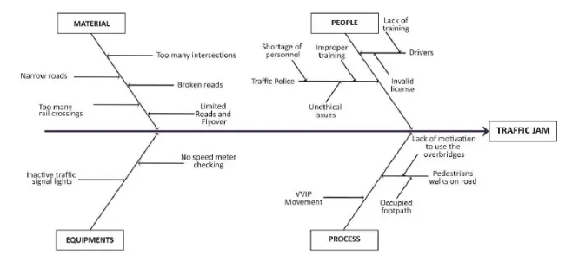
Example of fishbone diagram for traffic jam

Slide 24
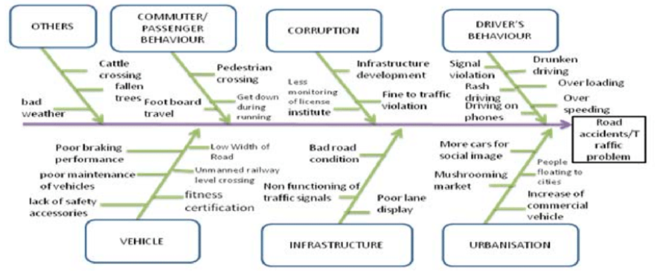
Example of fishbone diagram for traffic problem

Slide 25
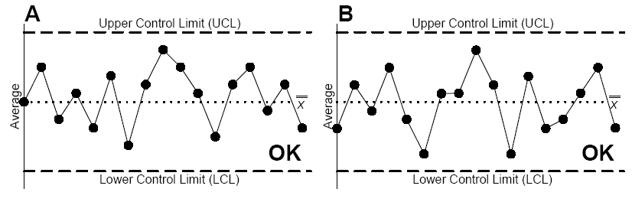
Control Chart Example

Slide 26
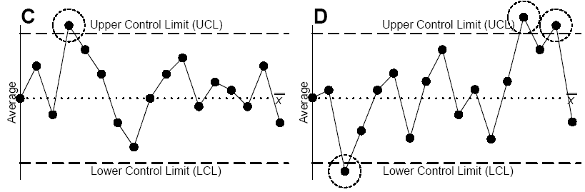
Conditions for a Process To be Out of Control

Slide 27
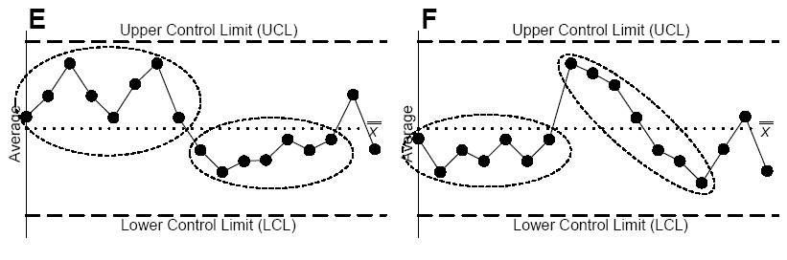

Slide 28
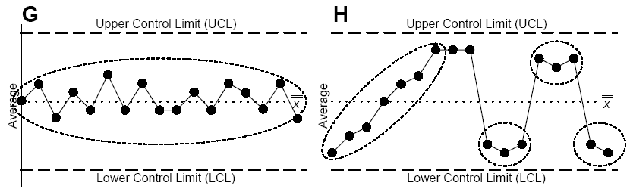

Slide 29
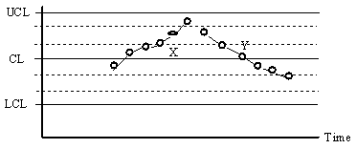
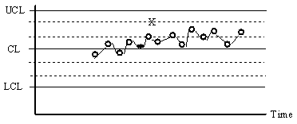
Patterns in Control Chart
Trends or Steady Changes in Level
Linear Trends
Oscillatory Trend

